Slide 1
DriverPass System Analysis
Stephanie Fox

Slide 2
System Requirements
Functional Requirements
Customer accounts and training packages
Schedule, change, or cancel lessons
Practice tests and progress tracking
Reports and DMV updates
Nonfunctional Requirements
Web and mobile access
Secure access based on user role
Reliable performance and data storage
Notes:
For the functional requirements, I selected the main things DriverPass needs the system to actually do. Customers should be able to create an account, choose a training package, schedule, change, or cancel driving lessons, and take practice tests. The system also needs to keep track of lesson information and test progress. Employees need to be able to register customers, manage appointments, record lesson notes, create reports, manage accounts, and update training information when the DMV sends changes.
For the nonfunctional requirements, I focused more on how the system needs to work. DriverPass needs a web-based system that can be accessed from computers and mobile devices. It also needs to protect customer information and give different levels of access depending on the user’s job. Common pages should load within about three seconds under normal conditions, and the system needs reliable storage for customer, appointment, training, and test information. This setup keeps everything easy to access while still protecting customer information.

Slide 3
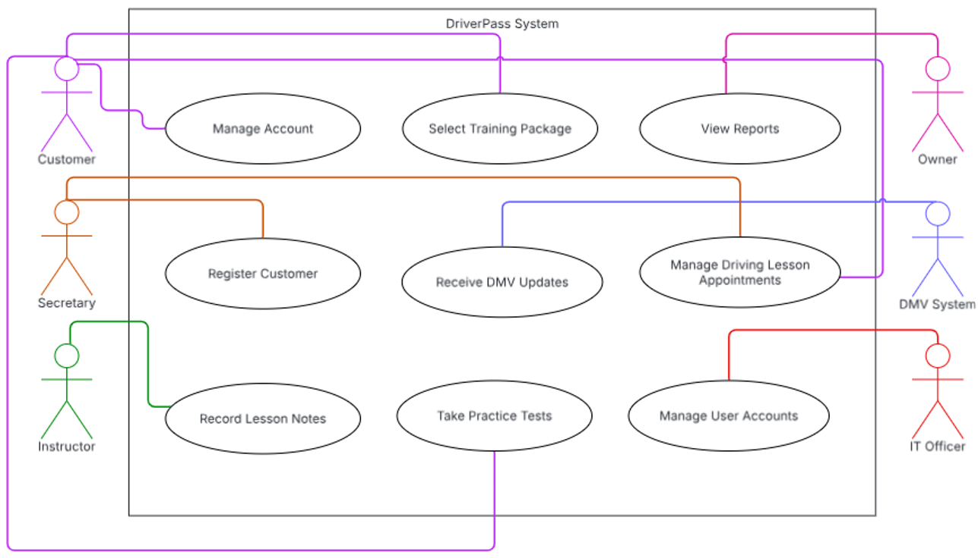
DriverPass
Notes:
This diagram shows the different people and groups that will interact with DriverPass and what each one needs to be able to do.
Customers can manage their account, select a training package, schedule driving lessons, and take practice tests. The secretary can register customers and help manage appointments, while instructors can record information from driving lessons. The owner needs access to reports, and the IT officer needs to manage user accounts and access. The system also connects with the DMV so DriverPass can receive updates when rules, policies, or sample questions change. I separated these responsibilities because not every person needs access to every part of the system. This gives each person the functions they need while keeping other information restricted.

Slide 4
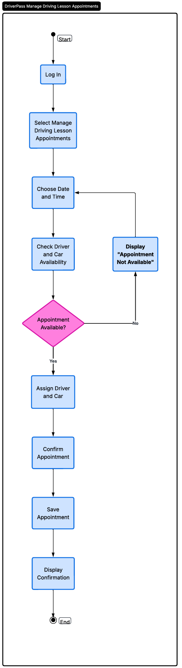
Driving Lesson Appointment
Notes:
This diagram breaks down the process for managing a driving lesson appointment. The customer first logs in and chooses the option to manage driving lessons. They select a date and time, and the system checks whether a driver and car are available.
If the appointment is not available, the customer is told that and can choose another date or time. If it is available, a driver and car are assigned, the appointment is confirmed and saved, and the customer receives confirmation. This helps DriverPass keep track of who’s driving, which car is used, and the date and time, and it also prevents double‑booking.

Slide 5
Security
Different access for each user role
Secure passwords and account lockouts
Protected customer and payment information
Password reset and account controls
Tracks changes made to appointments
Notes:
I considered security by limiting what each person can see and change in the system. Customers should only have access to their own account and training information, while employees should only have access to the parts of the system needed for their jobs. The IT officer has more control because that position is responsible for resetting, disabling, or blocking accounts when needed.
Accounts should temporarily lock after three failed login attempts, and passwords should meet basic security requirements. Customer and payment information also needs to be protected when it is stored or sent through the system. Another important part is keeping a history of appointment changes. This also helps DriverPass see who created, changed, or canceled a reservation if there is ever a problem.

Slide 6
System Limitations
Changes require an internet connection
System depends on cloud service availability
DMV updates are limited by what the DMV provides.
Major package changes require future development
Current design only includes requested features
Notes:
Every system has limitations, and DriverPass is no different. One limitation is that users need an internet connection to make changes in the system. Reports can still be downloaded and viewed offline, but customer records, appointments, and other information should only be updated while connected so there are not different versions of the same information. The system also depends on the cloud service being available. If there is an outage, customers and employees may not be able to access the system until service is restored. DMV updates are also limited by what the DMV provides, so some changes may need to be entered manually if there is not a direct way to receive them.
DriverPass can disable a training package if it no longer wants customers to select it, but larger changes to the packages would need additional development. The current design also focuses on the features DriverPass asked for now, so any new features would need to be added in a future update.

